Slide 1
INDEPENDENT STUDY PROJECT Prediction of Community Growth Patterns Using Census Data and Road Network Characteristics
Dane Sheppard
Presented on July 30, 2024

Slide 2

Outline
Introduction and research questions
Dataset and exploratory data analysis
Preprocessing methodology
Initial scope: predicting New Brunswick
Expanded scope: Canada
Conclusions and future work

Slide 3
Introduction
Predicting how populations change over time is important for community planning
Current methods are often labour intensive and require considerable expertise to execute
Population studies often commissioned via Request for Proposal process, which is time consuming and expensive for the community
Can we use HPC to help?

Slide 4
Research Questions
Can census data from different census years be used to train a model to predict population change over time within a limited geographical scope (eg. provincial scale)?
Does the inclusion of geospatial characteristics ( road network characteristics, building density, population density, etc.) improve the prediction capability of the model from research question 1?
Do prediction capabilities persist when geographical scope is expanded to several provinces, or to a Canada-wide analysis?

Slide 5
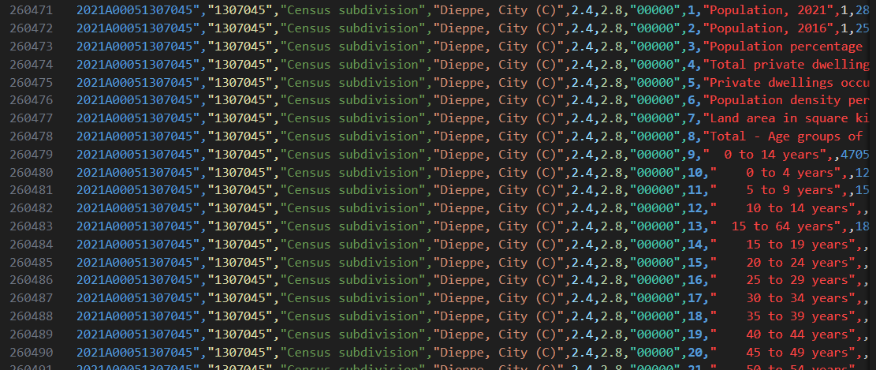
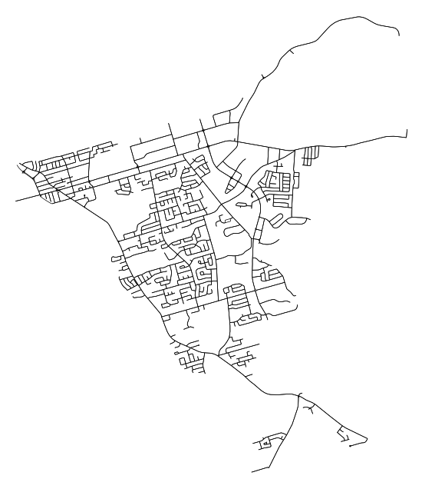
Dataset – Statistics Canada and OSMNX
Census Data
2011 - No API available
2016 - API available
2021 - Different API available
Direct downloads easier
OSMNX
Python library built on top of NetworkX, a library for network analysis. OSMNX lets road networks be downloaded in NetworkX format

Slide 6
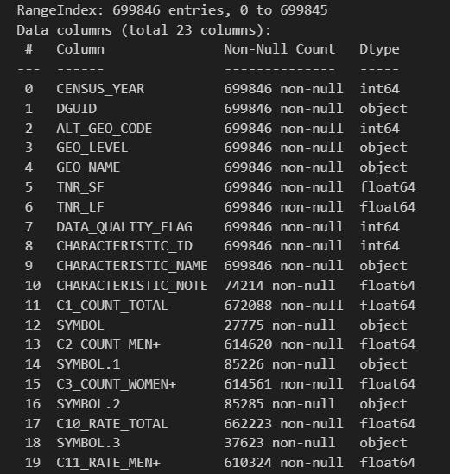
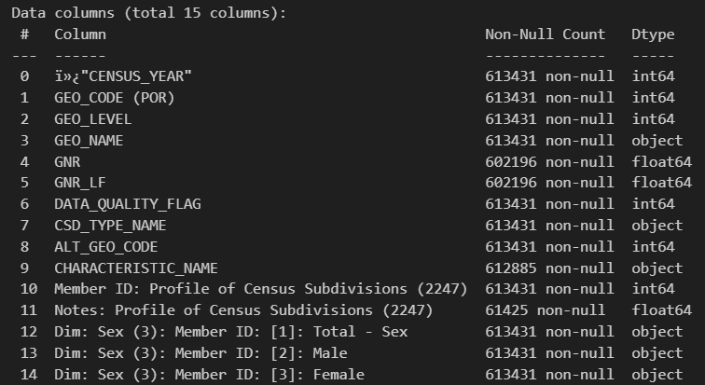
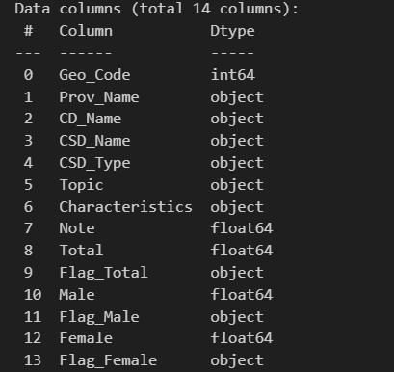
Exploratory Data Analysis – The perils of government data
2016 Data
2011 Data
2021 Data

Slide 7
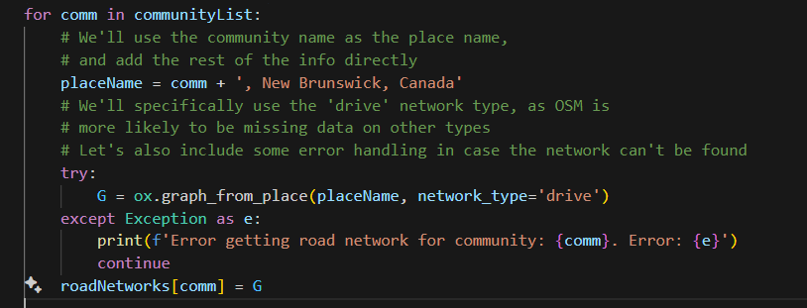
Exploratory Data Analysis – The perils of government data
Computation time: ~1 h,
Node connectivity - The minimum number of nodes that must be removed to disconnect the network. Useful for understanding how robust a road network is to node failure.
Betweenness Centrality - The sum of the fraction of all-paris shorts paths that pass through the node. Allows us to understand how important a node is in the network, and can be used to identify key nodes.
Average node degree - The average number of edges connected to a node. Helps in understanding how well-connected a network is overall.

Slide 8
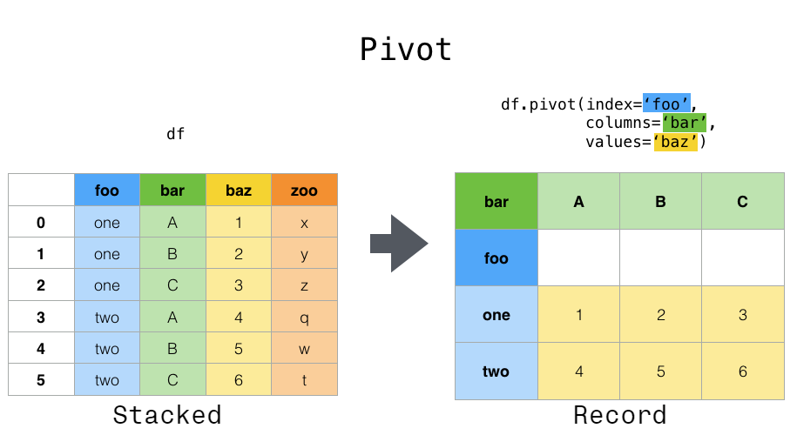
Preprocessing Methodology – Pivoting the Census Data
Source: https://pandas.pydata.org/docs/user_guide/reshaping.html

Slide 9
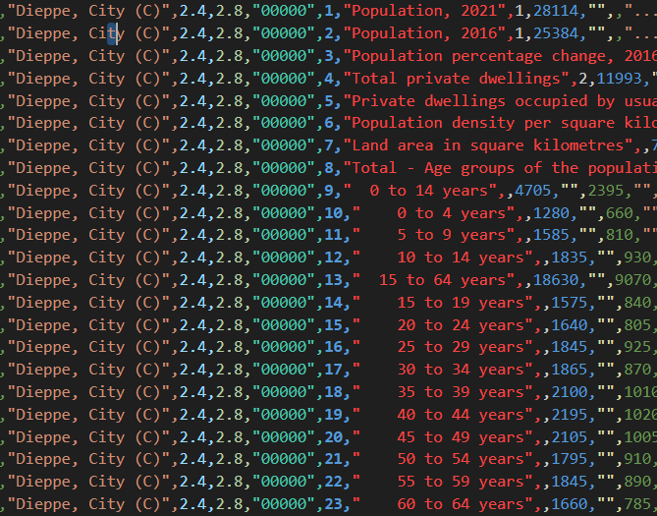

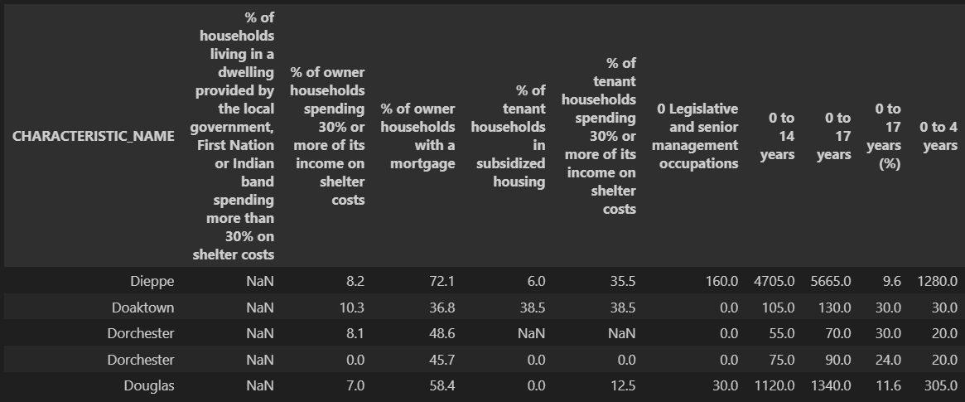
Preprocessing Methodology – Pivoting the Census Data

Slide 10
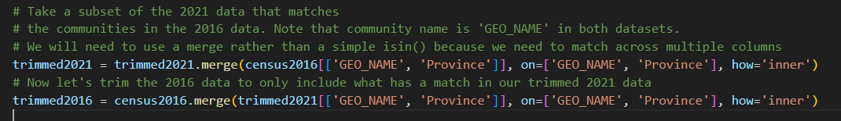
Preprocessing Methodology – Census cleanup
Census Data
Regex cleanup
Matching across years
Unifying feature names
Reformatting community names

Slide 11
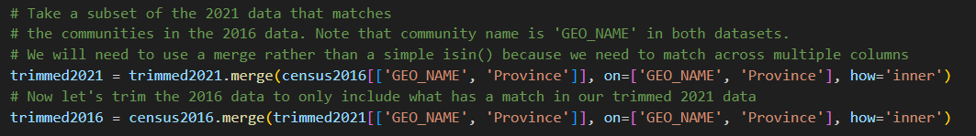
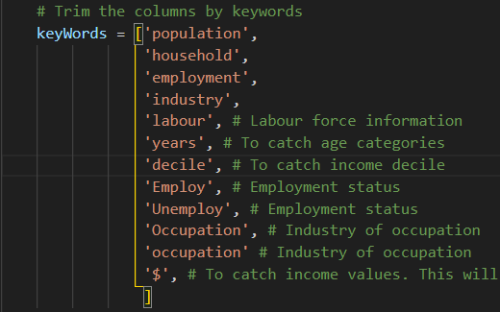
Preprocessing Methodology – Census cleanup
Census Data
Trimming datasets for identical community lists
Selecting features

Slide 12
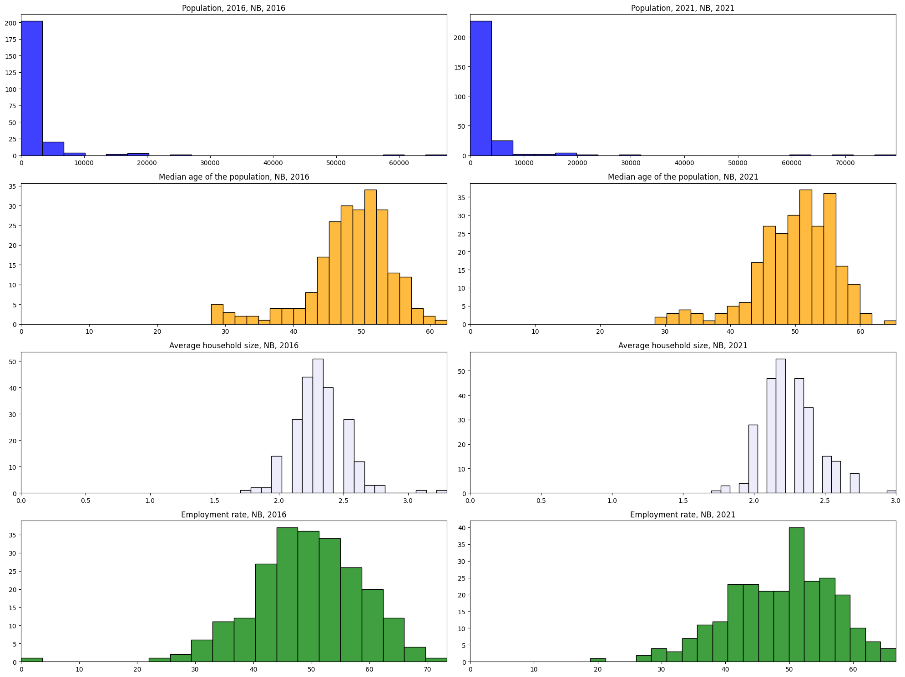

Slide 13
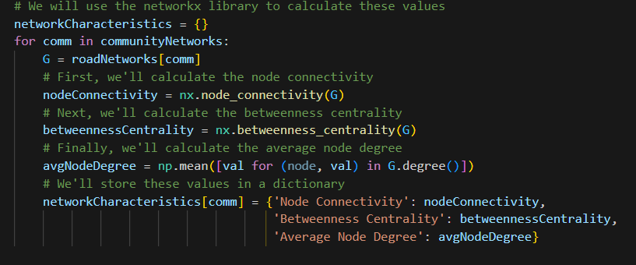
Preprocessing Methodology – Geospatial Data
Use OSMNX to extract network characteristics

Slide 14
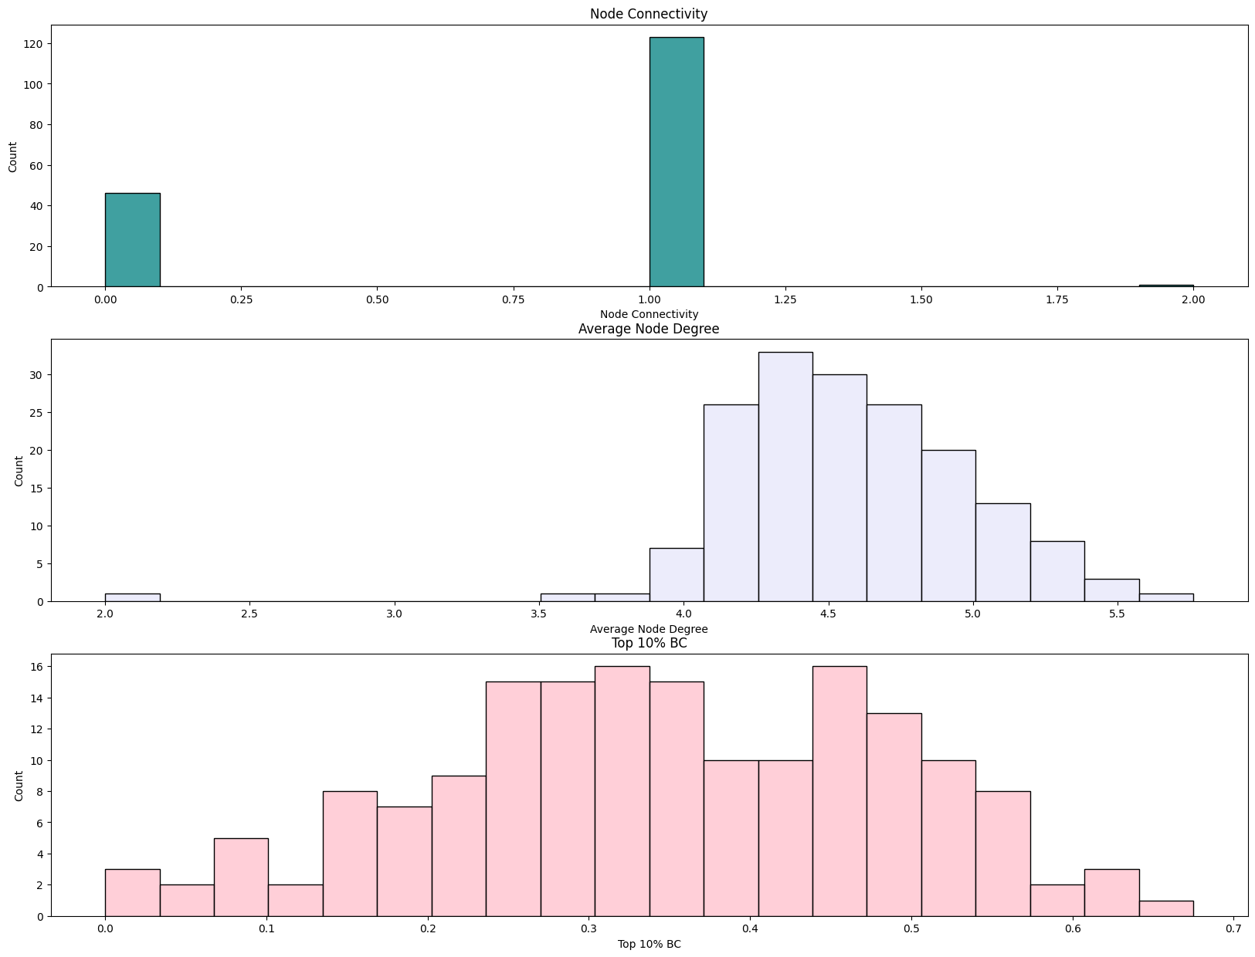
Distributions of road network characteristics for New Brunswick

Slide 15
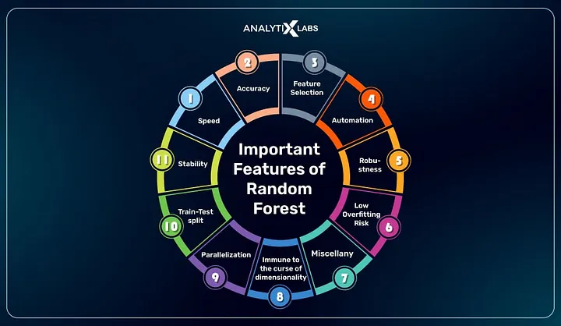
Initial Scope – Predicting New Brunswick
Random Forest Regressor
All numerical data
Train on all selected features from 2016 data
Predict ‘Population, 2021’ value from 2021 dataset
Four scenarios:
Census only (NB)
Network only (NB)
Census + network characteristics (NB)
Predict NL with NB model

Slide 16
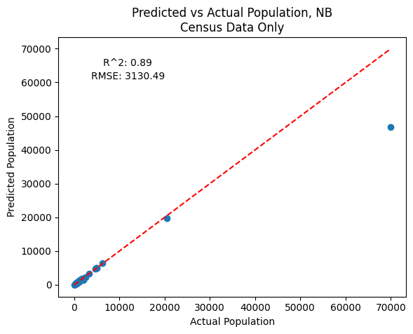
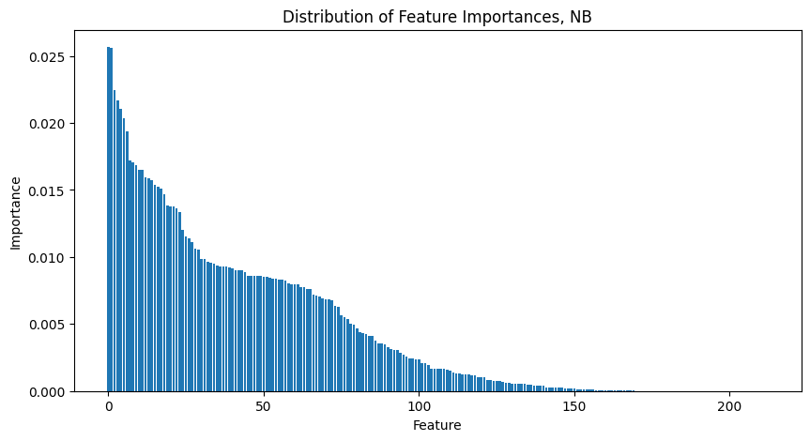
Initial Scope – Predicting NB, Census only

Slide 17
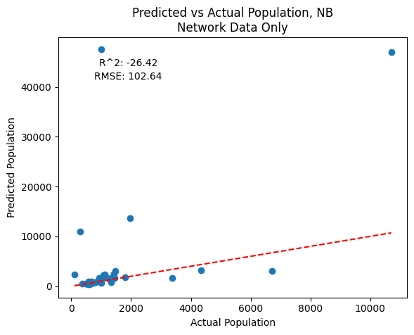
Initial Scope – Predicting NB, Road Network Only

Slide 18
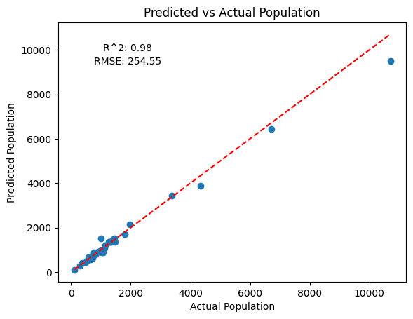
Initial Scope – Predicting NB, Combined Dataset

Slide 19
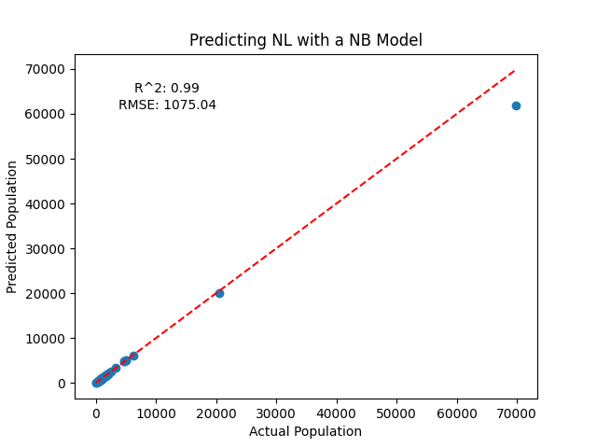
Initial Scope – Predicting NL with NB Model

Slide 20
Expanding Scope – Coast to Coast
Functionalize the entire process carried out for analysis up to this point. Provincial datasets are easier to work with, and we will avoid the road network characteristics for scaleup.
Three main workhorse scripts:
censusProcessing.py, which ingests the 2016 and 2021 data for a given province => output to /processedData
dataAssembly.py, which assembles the provincial datasets from /processedData into a single dataframe for each year
popGrowthModelTraining.py, which trains and tunes models for the full dataset, a subset of communities <100k, and an additional subset of communities <30k.

Slide 21
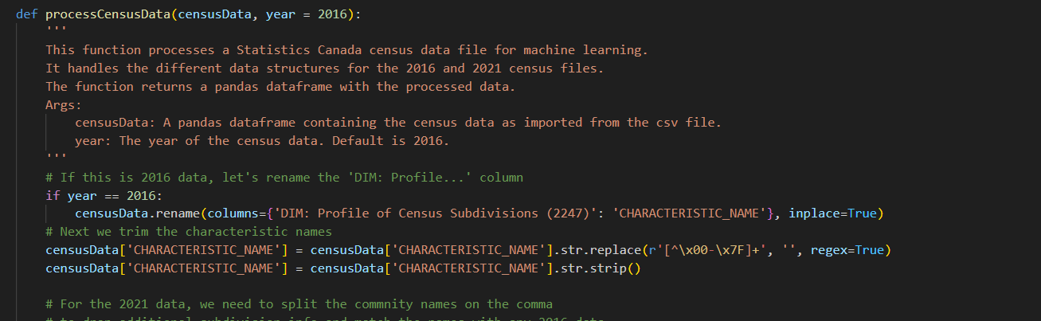
Expanding Scope – Census Processing

Slide 22
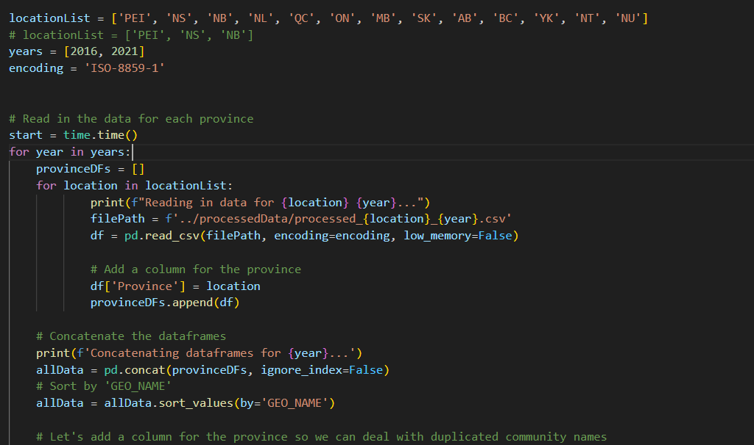
Expanding Scope – Data Assembly

Slide 23
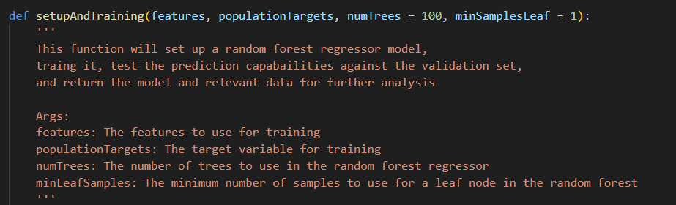
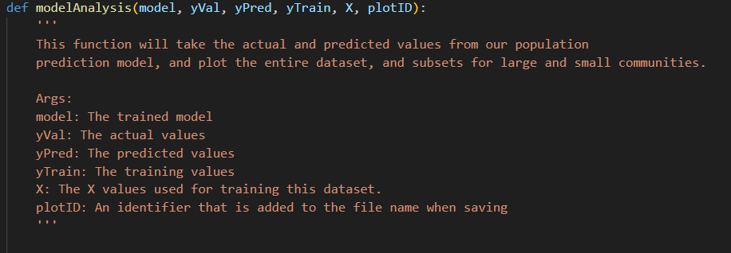
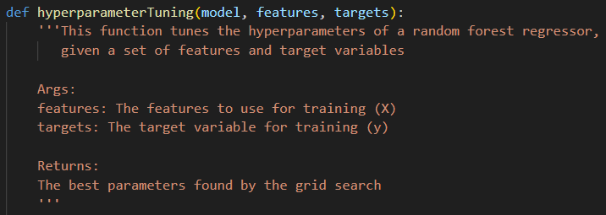
Expanding Scope – Training the model

Slide 24
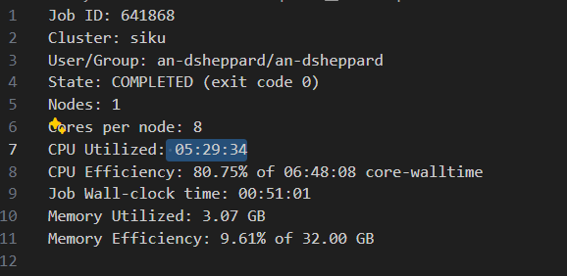
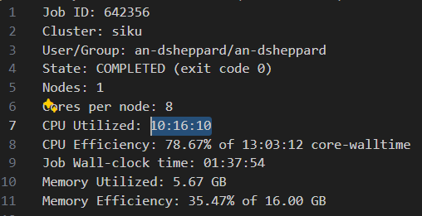
Expanding Scope – Coast to Coast
Single-threaded hyperparameter tuning (~175 fits), one model for full population
Multithreaded hyperparameter tuning (8 cores), for full, <100k, <30k models

Slide 25
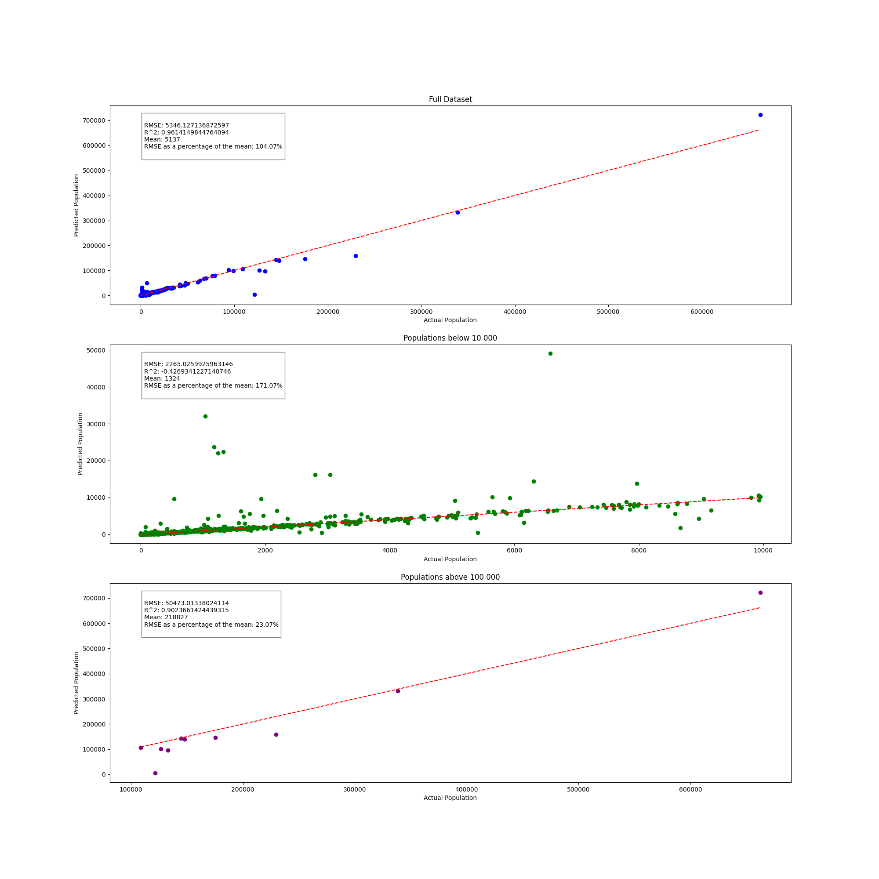
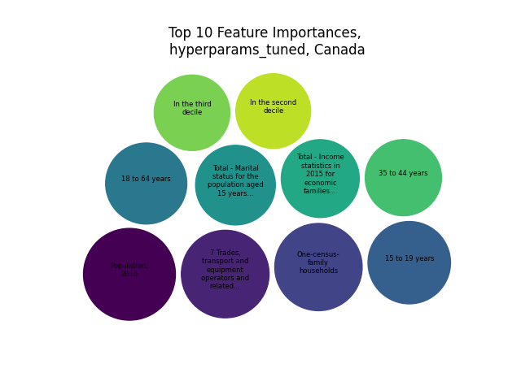
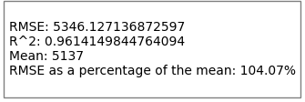
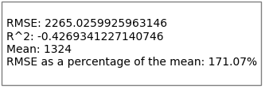
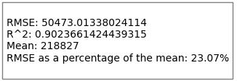
Expanding Scope – Training Results

Slide 26
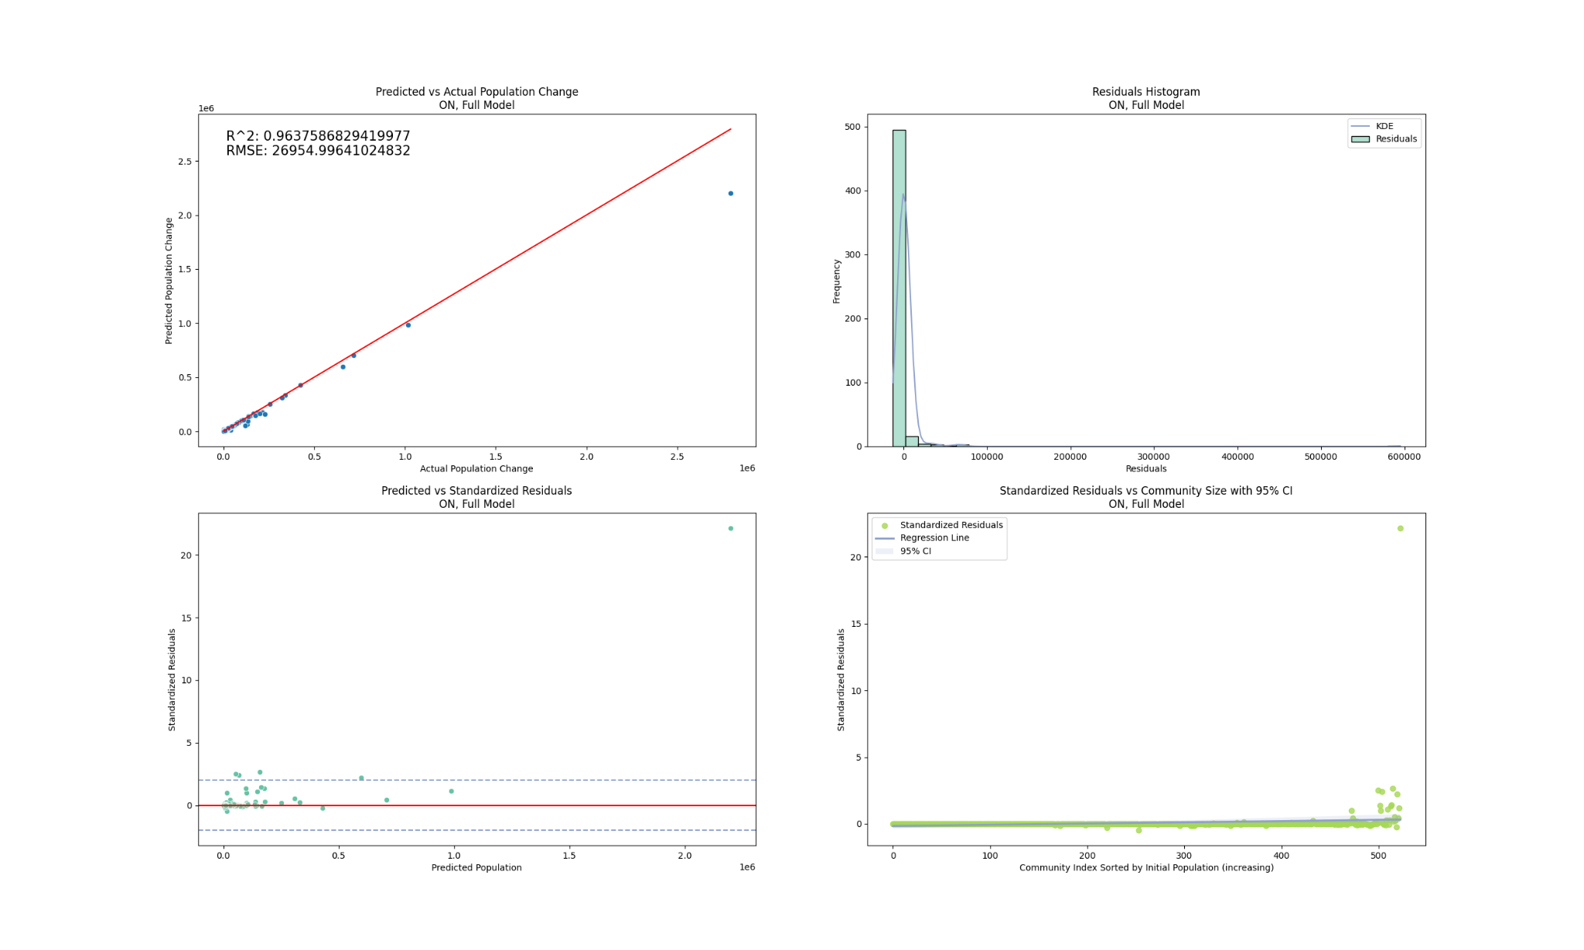
Expanding Scope – Results, Predicting ON (Full Model)

Slide 27
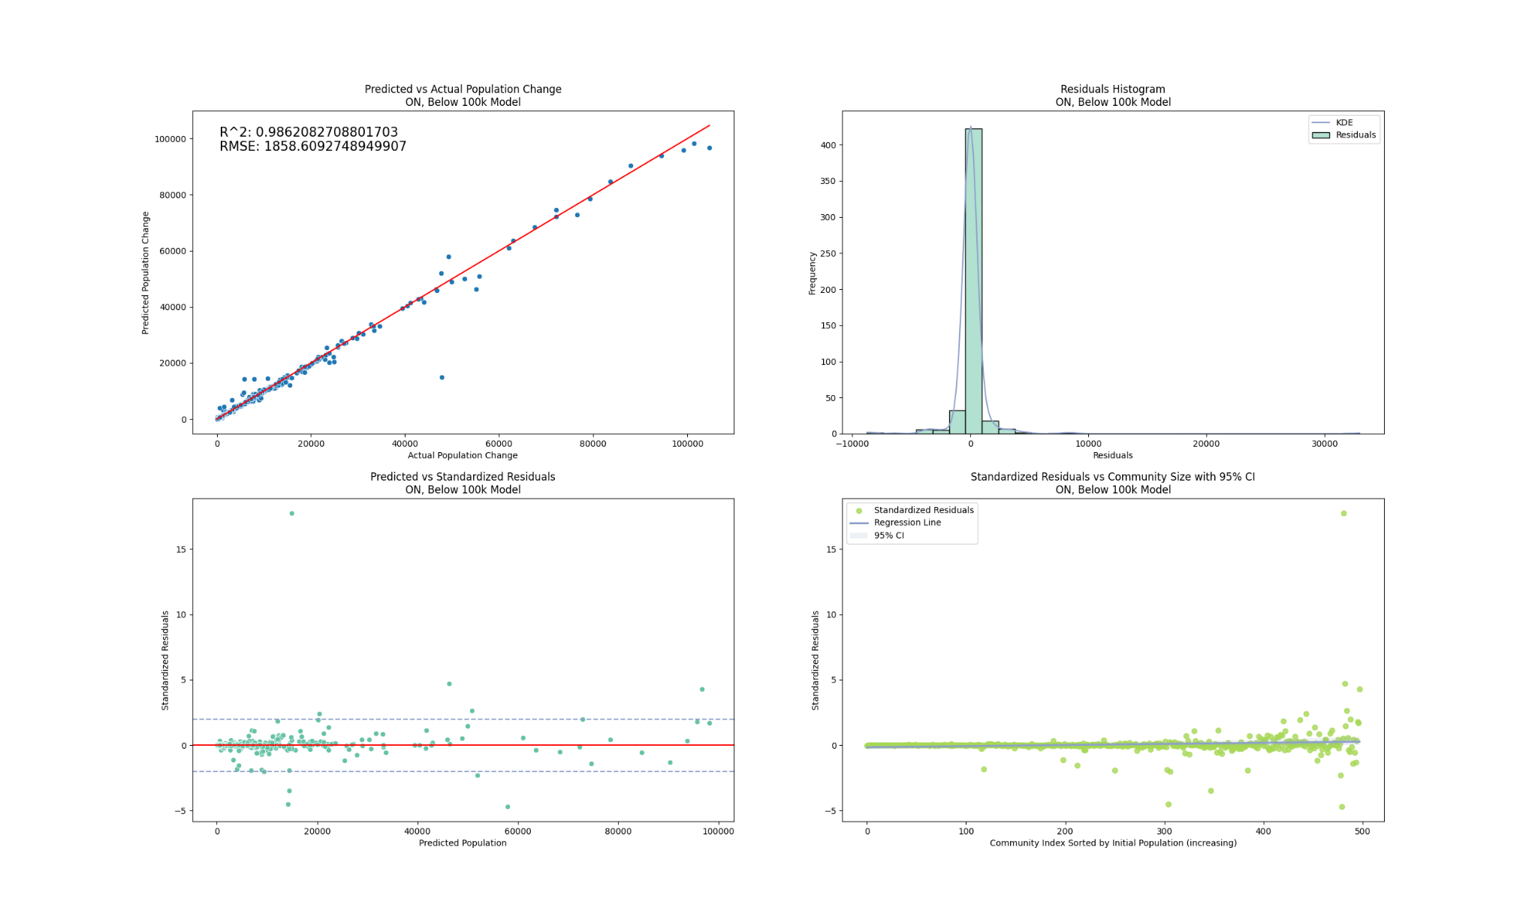
Expanding Scope – Results, Predicting ON (<100k)

Slide 28
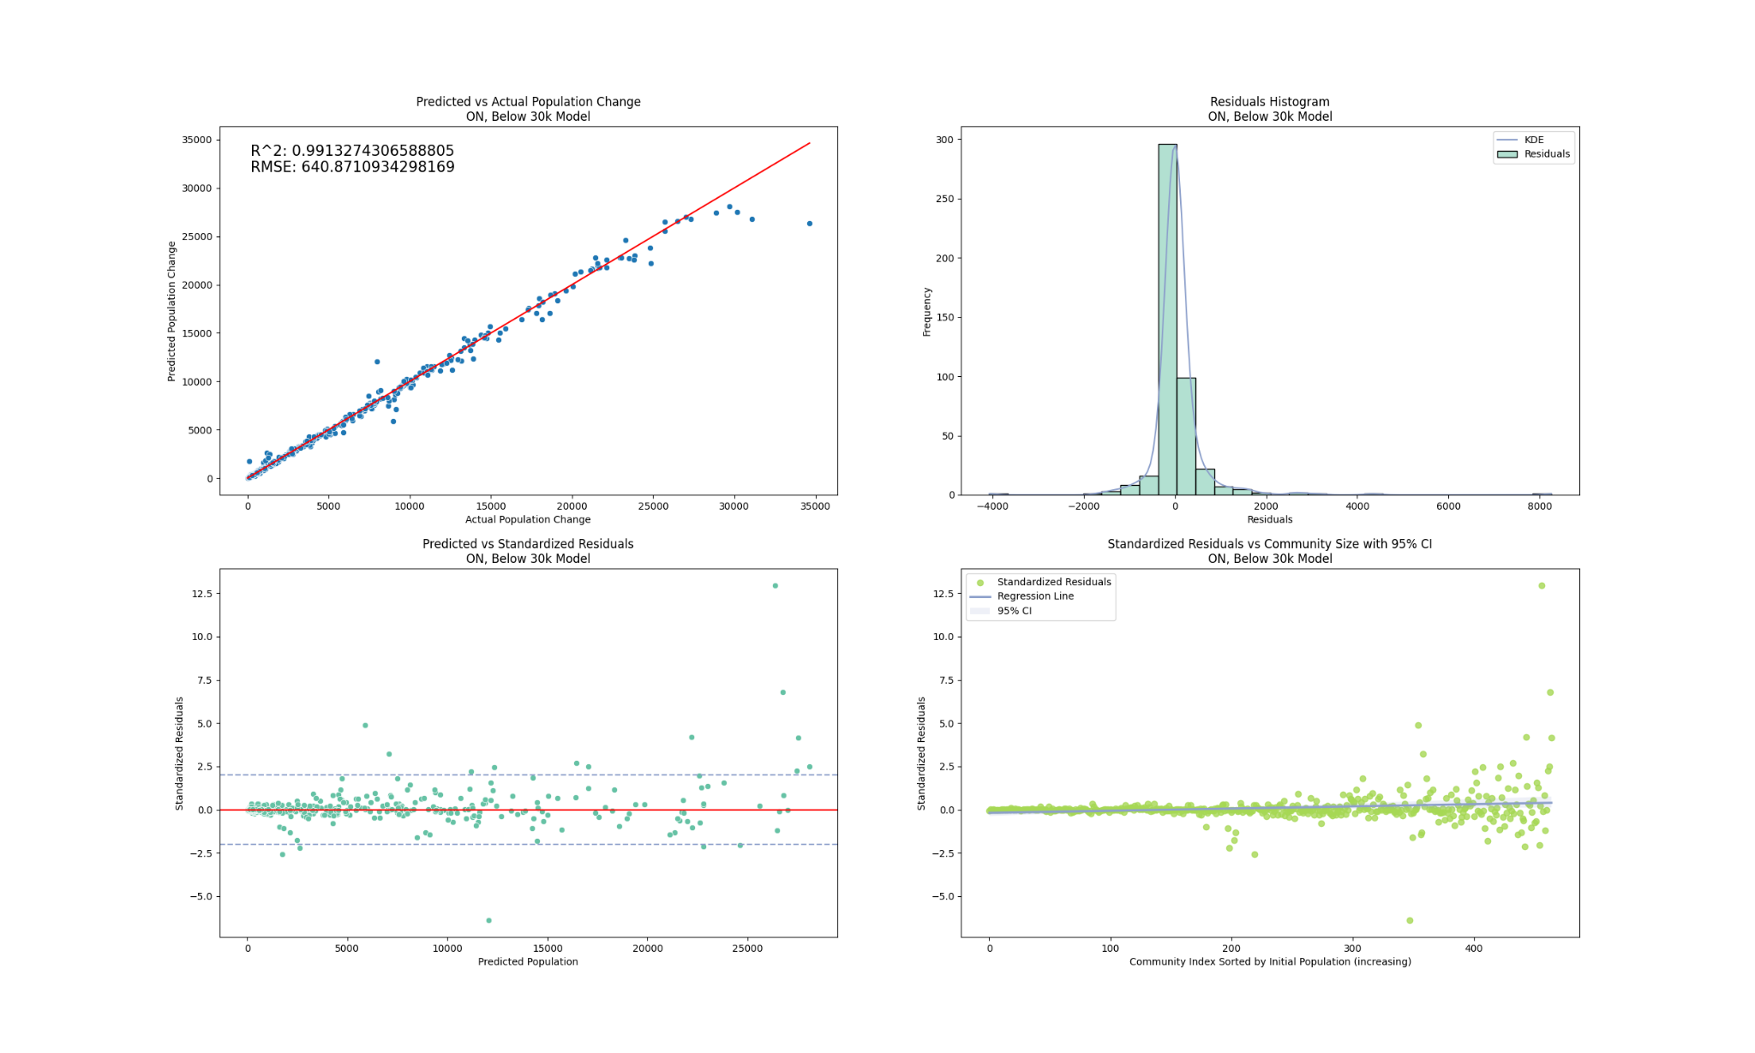
Expanding Scope – Results, Predicting ON (<30k)

Slide 29
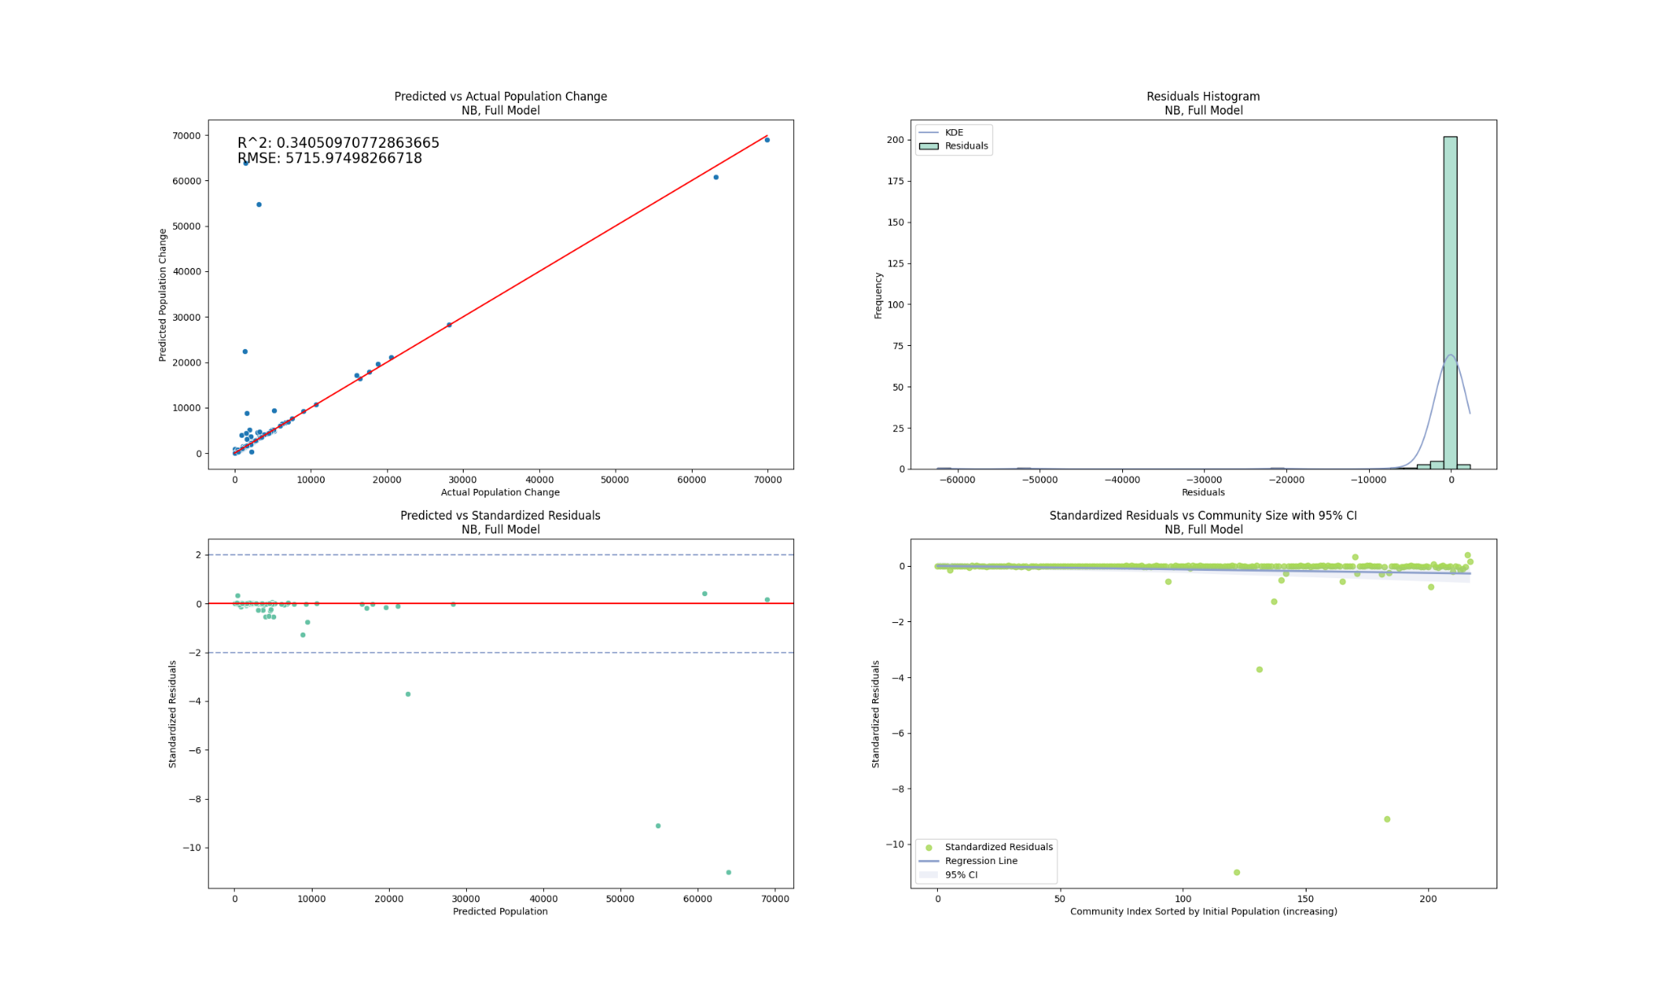
Expanding Scope – Results, Predicting NB (Full)

Slide 30
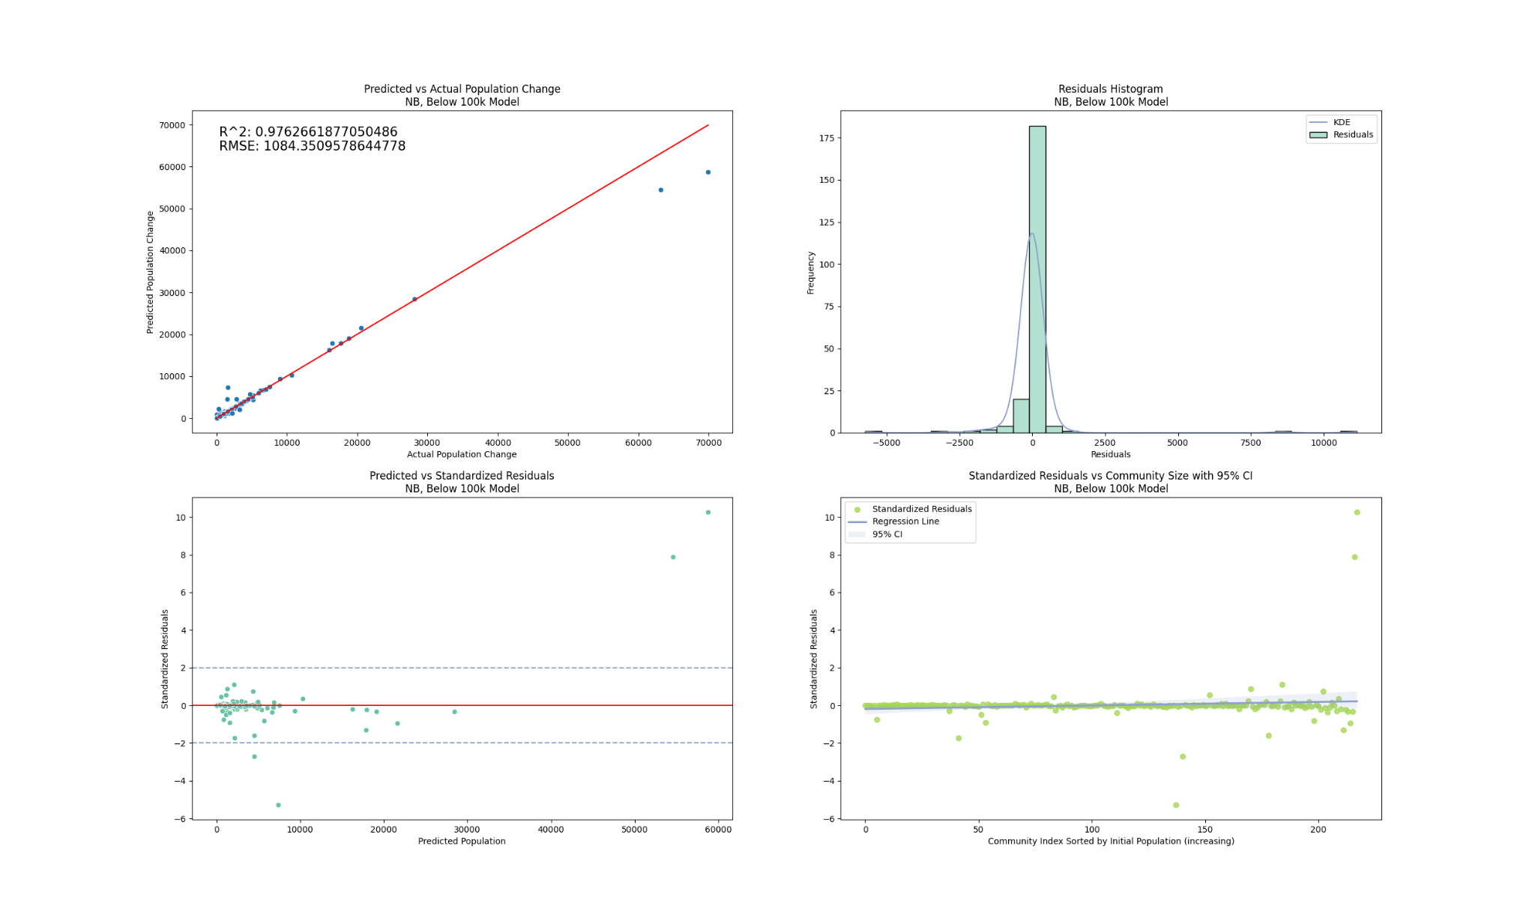
Expanding Scope – Results, Predicting NB (<100k)

Slide 31
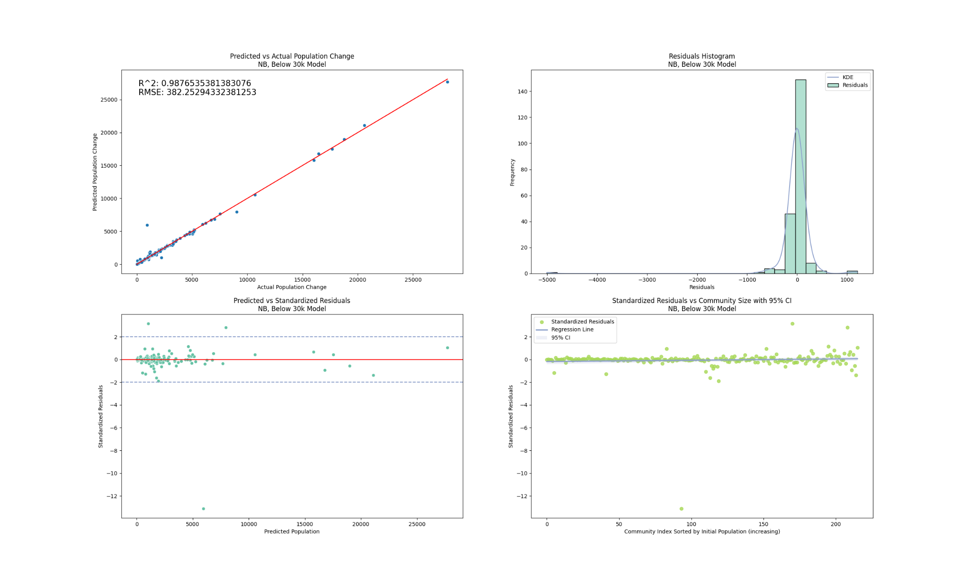
Expanding Scope – Results, Predicting NB (<30k)

Slide 32
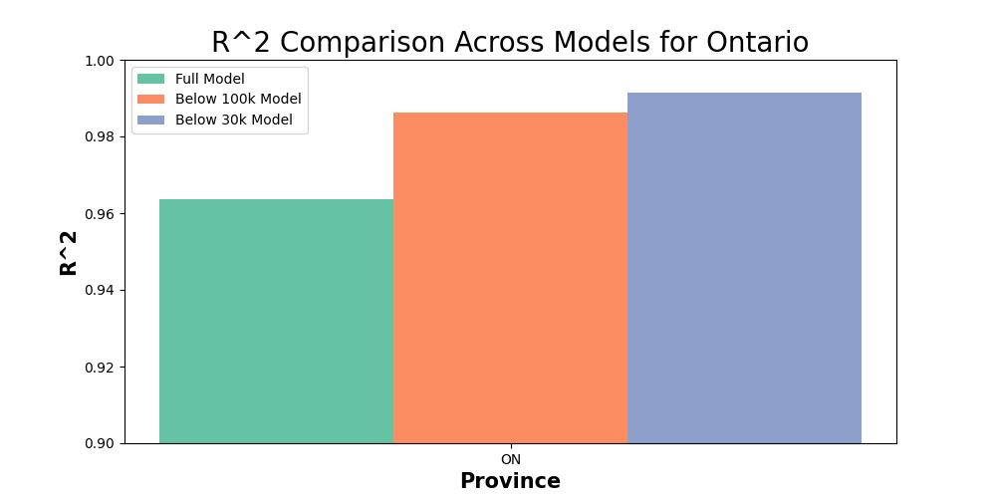
Expanding Scope – Comparing Ontario R²

Slide 33
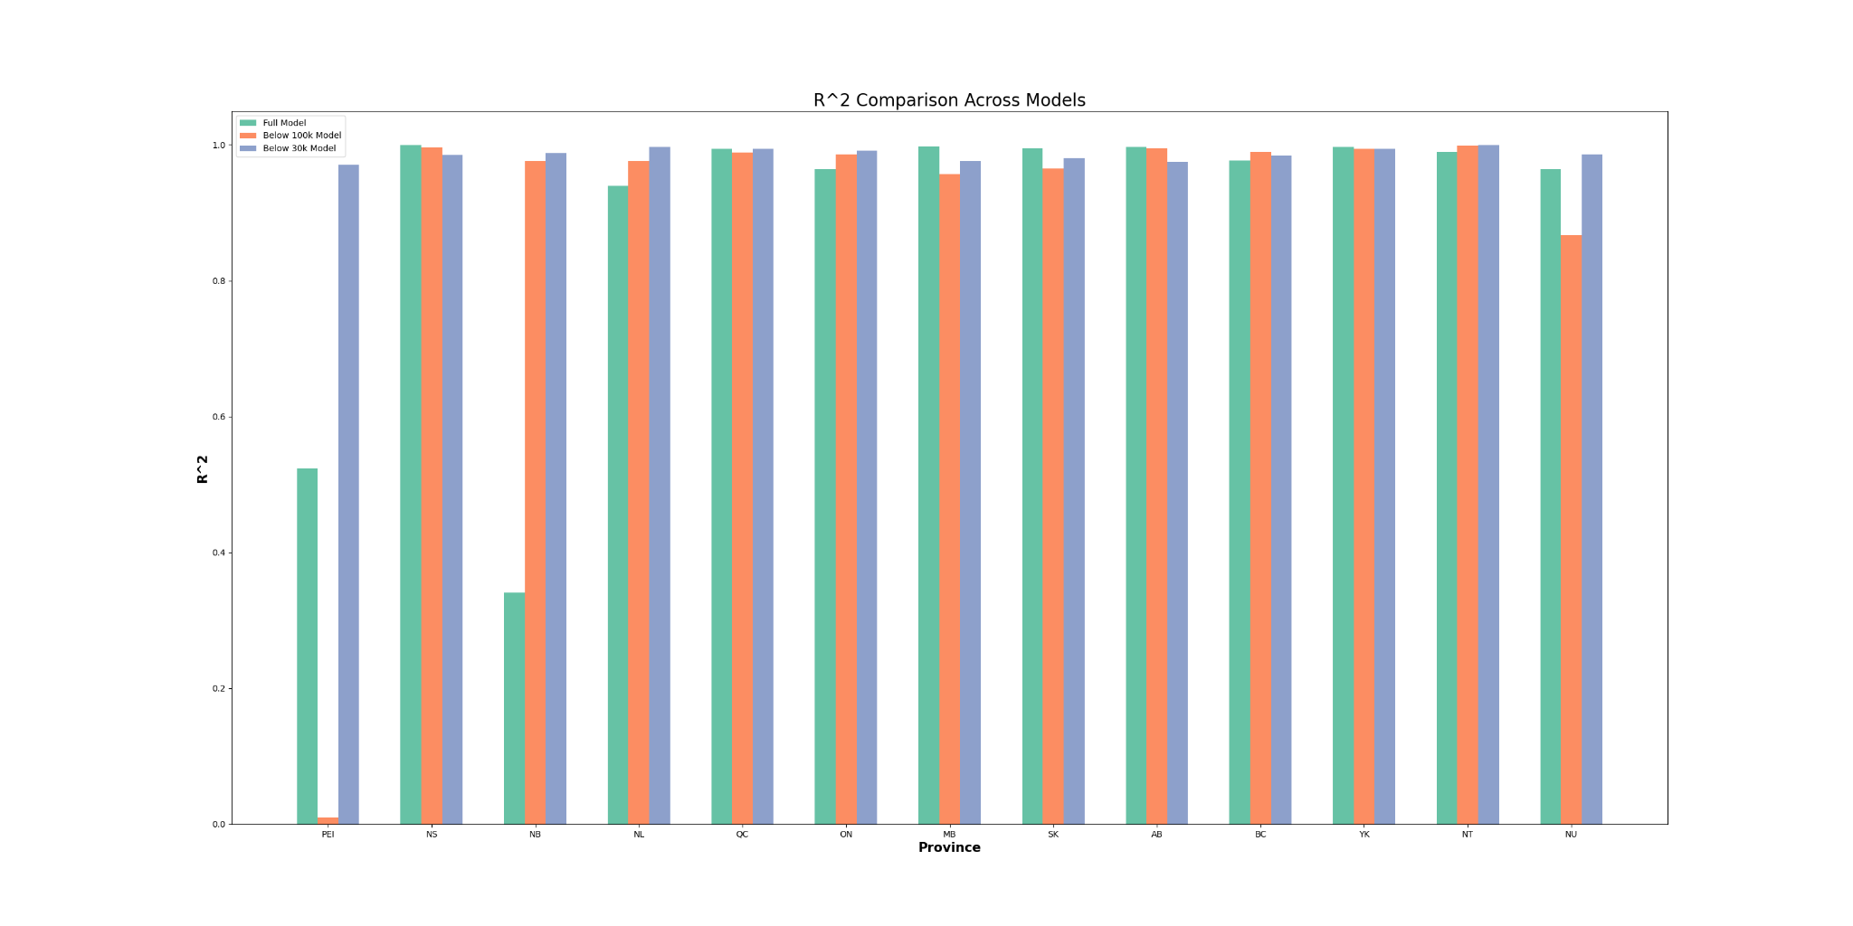
Expanding Scope – Comparing R² Across Provinces

Slide 34
Conclusions and Future Work
Conclusions
Dataset heavily weighted to smaller communities, so the model tends to underestimate growth in larger communities
RQ1 & RQ3, predictive capability good, and seems scaleable, with some limitations
RQ2: Road network characteristics largely superfluous when working with full census data files
Future work
Recursive feature elimination
Explore other road network characteristics
Explore machine vision applications to predict how the map of a community might change in accordance with population change

Slide 35

Questions?
xkcd, October 9, 2020

